Slide 1


Micropython With ESP8266

Slide 2
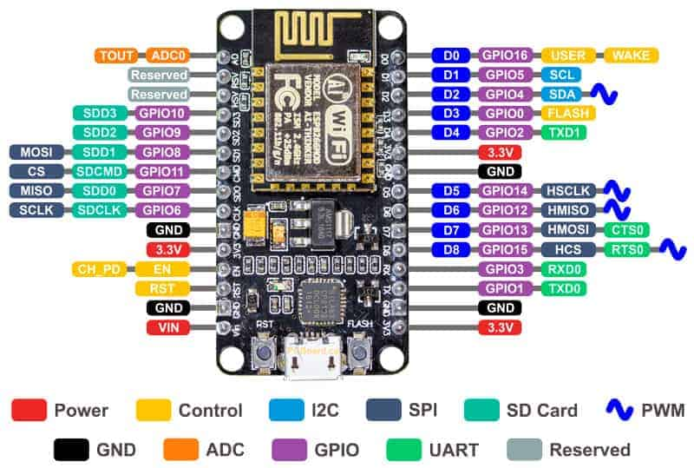
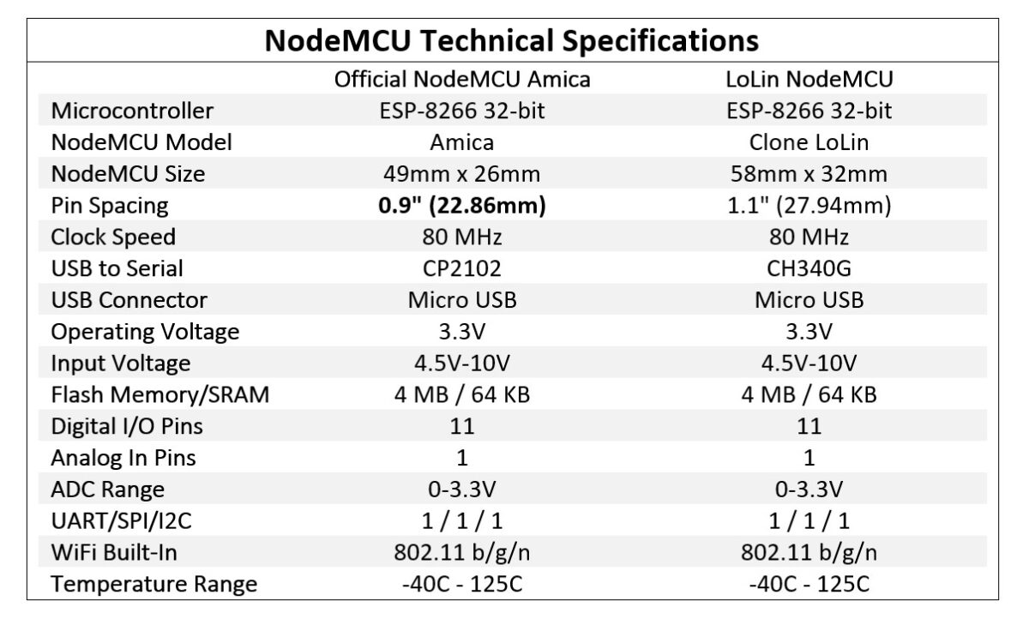

Slide 3
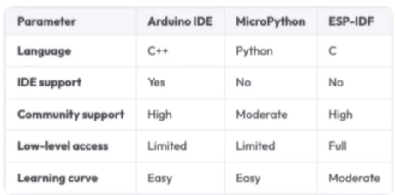

Slide 4
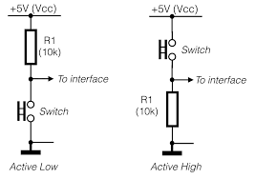
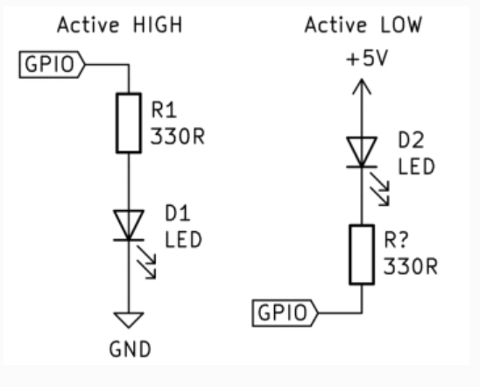

Slide 5
Install python
Install driver on windows
Install firmware

Slide 6
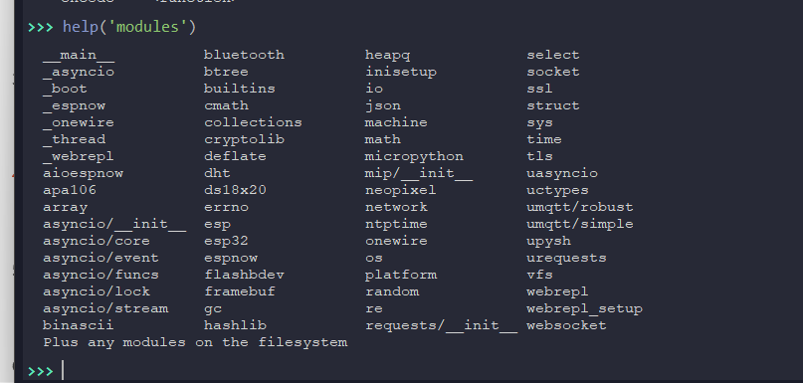
MicroPython libraries

Slide 7
Function
bdev - a global variable which points to the default partition.
Vfs – virtual filesystem control (module)
gc – control the garbage collector (micropython-lib)
1 modules
2- variables
3- function
4- conditional statements control flow

Slide 8
Libraries specific to the ESP8266
1- esp.sleep_type([sleep_type])
The possible sleep types are defined as constants:
SLEEP_NONE – all functions enabled,
SLEEP_MODEM –shuts down the WiFi Modem circuit.
SLEEP_LIGHT –shuts down the WiFi Modem circuit and suspends the processor periodically.
2 - esp.flash_size()

Slide 9
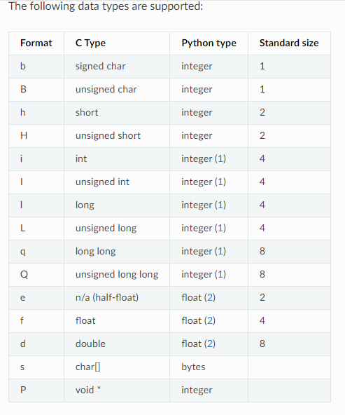

Slide 10
THANK YOU

